Slide 1

Survey Research in CS/IS/IT
RESEARCH METHODOLOGY AND SCIENTIFIC WRITING
COMPUTER SCIENCE FACULTY, UNIVERSITY OF INDONESIA

Slide 2


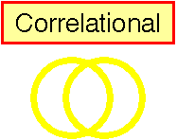


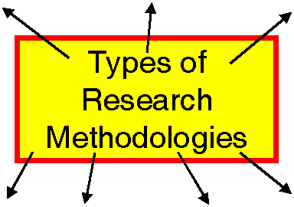








Recall: Research Methodologies

Slide 3
What’s a Survey?
The survey is a group of research methods commonly used to determine the present status of a given phenomenon
A survey is a systematic method of collecting primary data based on a sample
Survey may be used for
exploratory,
descriptive
causal studies

Slide 4
Survey Research Design
Research design refers to how the survey will be administered in terms of:
targeted groups,
comparisons of data to multiple groups,
frequency of survey administration.
A cross-sectional survey design:
At a defined time.
Experimental or quasi-experimental designs
Can be conducted via survey

Slide 5
Characteristics of Survey Research
Quick and wide coverage
Exhaustive as opposed to in-depth
Exploratory as opposed to definitive
Descriptive as opposed to analytic
Correlational causality for experimental or quasi-experimental research

Slide 6
Survey Method
Collecting standardized information from people using an interview or self-report format.
Typically survey knowledge or opinions.
To standardize the information, one uses a questionnaire with set questions.
Ideally the questionnaire has been validated.
Representativeness of the sample is very important.

Slide 7

Interviews
Direct interview
Face-to-face
Via telephone
Chat
Indirect interview
Via email

Slide 8
Interviews
ADVANTAGE
DISADVANTAGE
Comprehensive
Ensures participant understands the question, minimizes missing data, enables clarification of unclear responses
Expensive (time, effort, and resources)
People are more likely to refuse participation, can be risky for interviewer, interviewer may bias the responses

Slide 9
Structured and Unstructured Interviews
Structured
Unstructured
Questions are pre-planned in advance to elicit responses in a specific area
Benefits
Consistency
Even coverage
Content validity
Issues
Limits coverage
Questions are unplanned. The interviewer can ask questions at his/her discretion
Benefits
Cover a wide range of issues
Flexibility
Issues
Reliability
Validity

Slide 10
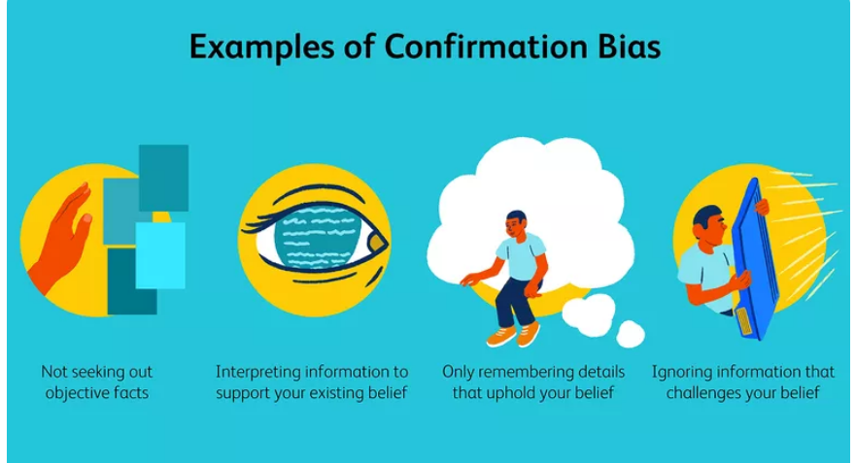
Interviewing Errors
Confirmation bias
an error in which the interviewer unconsciously seeks to gather information to support an established opinion or point of view
https://www.verywellmind.com/what-is-a-confirmation-bias-2795024

Slide 11

Survey vs Questionnaire
A survey is the process of evaluation of experiences or opinions of a group of people via questions.
A questionnaire which is defined as a collection of written or printed questions with an answer choice made to conduct a survey.
In other words, “questionnaire” describes content, while “survey” is a broader term that describes content, method, and analysis.
Many people, even professional researchers, still use the two terms interchangeably.

Slide 12
Creating Questionnaires
Step 1.
Determine The Purpose
Step 2.
Target Population
Step 3.
How Will The Survey Be Evaluated?
Step 4.
How Will The survey be Administered?
Step 5.
Determine The Question Format
Step 6.
Question Construction
Step 7.
Develop Response Scale
Step 8.
Pilot Test
Step 9.
Distribute The Survey

Slide 13
How to Administer the Survey?
Step 4.
How Will The survey be Administered?
The pandemic has made things tricky…

Slide 14
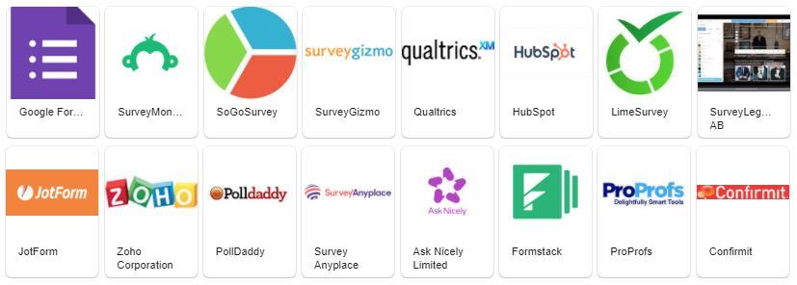
Online Questionnaire Methods
Step 4.
How Will The survey be Administered?

Slide 15
Open-ended Questions
Step 5.
Determine The Question Format
Can you tell me about your typical experience with writing?
Advantages
Freedom of response
Sensitive to respondents’ desire for expression
Well-suited for exploratory studies
Suitable for certain types of questions
Disadvantages
Interpretation of the responses can bias the findings
Researchers must form representative categories that encompass all responses
May discourage respondents from completing the questionnaire
Coding open-ended questionnaires can be expensive and time-consuming

Slide 16
Determine The Question Format
Step 5.
Determine The Question Format
Close vs Open Ended Questions
Dichotomous Questions
Multiple-Choice Questions

Slide 17
Closed-ended Questions
Step 5.
Determine The Question Format
How do you typically find a research question?
given by someone
the future work of an article
real-life problems
discussion with experts
toss a coin
Advantages
Easy to administer
Reduce interpreter bias
Tend to motivate respondents to complete surveys
Simplify coding and tabulating efforts
Prompts choices prompts respondents to ponder alternatives they might not otherwise consider
Disadvantages
Extensive effort required in questionnaire construction to create an exhaustive list of choices or a short list of the most likely choices
The list can have an inhibiting effect on respondents
Relying on the respondent to know whether to “select one” or “check all that apply”

Slide 18
Dichotomous Questions
Step 5.
Determine The Question Format
Closed-ended questions that only offer two response choices
Used to understand respondent’s demographic composition or behavioral inclination
Advantages
Usually do not require much time or thought on the part of the respondents
Minimize interpreter bias
Simplify coding and analysis process
Disadvantages
Omission of intermediate points

Slide 19
Multiple-Choice Questions
Step 5.
Determine The Question Format
Multiple choice questions, are closed-ended questions that give respondents several choices
Advantages
Reduce interpreter bias
Easy to complete
Simple to code and analyze
Free of bias in grading
More valid and reliable than open-ended questions
Disadvantages
Researchers must create carefully worded questions and exhaustive lists of choices to ensure that responses are representative

Slide 20
Questionaire Problems
Step 6.
Question Construction
Double-barreled questions
Ambiguous questions
Ambiguous word meanings
Leading questions or phrases
Level of question difficulty
Unbalanced response categories
Missing response categories
Missing questions
"How satisfied are you with your pay and job conditions?”
“How fast was the red car going when it smashed into the blue car?”

Slide 21
Develop Response Scale
Step 7.
Develop Response Scale
Likert Scale
Graphic Rating Scale
Rank Ordering

Slide 22
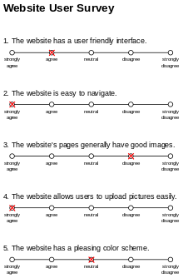
Likert Scale
Step 7.
Develop Response Scale
Likert scale is a psychometric scale commonly involved in research used to represent people's opinions and attitudes to a topic or subject matter.
Variants: 4,5,7 points…

Slide 23
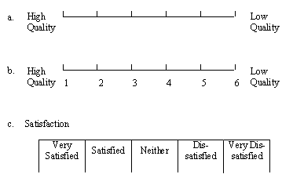
Graphic Rating Scale
Step 7.
Develop Response Scale
http://survey.pearsonncs.com/planning/response-scales.htm

Slide 24
Rank Ordering
Step 7.
Develop Response Scale
Example:
Rank order your preference for the following ice cream flavors from 1= most preferred, to 5 = least preferred.
____ Chocolate
____ Vanilla
____ Cherry
____ Banana
____ Broccoli

Slide 25
Good or Bad Examples?
How friendly do you feel the information system is?
a. Yes
b. No
How frequent do you use the information system?
a. 0 – 15
b. 15 – 20
c. 22 – 30
d. 33 – 50

